Slide 1
HTML Id

Slide 2
Agenda
HTML Id
Sample output
HTML Id implementation

Slide 3
HTML Id
HTML Id’s are unique id’s given to a tag to uniquely identify it.
These Id’s can also help us to style the tag.
We create id in the tag and declare the id in style tag which is inside head tag.

Slide 4
HTML Id syntax
<html>
<head>
<style>
#Id name 1{
Property: value
Property: value
}
#Id name 2{
Property: value
Property: value
}
</style>
</head>
<body>
<Tag name class =”Id name 1”> Text here</Tag name>
<Tag name class =”Id name 2”> Text here</Tag name>
</body>
</html>

Slide 5
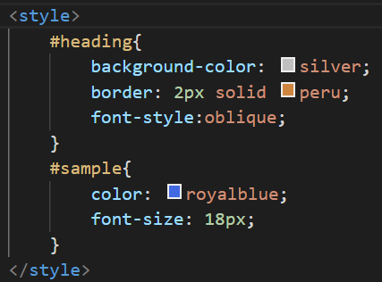
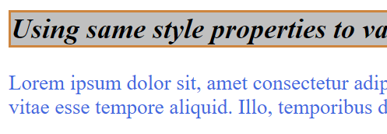
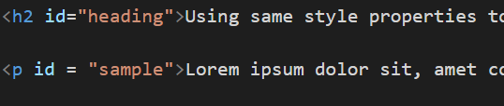
Sample output

Slide 6
HTML Id implementation
Let’s see HTML Id implementation.

Slide 7
HTML Id vs HTML class
S.No | Id | Class
1 | Id is used to uniquely identify a tag with unique name | Class is not used to uniquely identify a tag.
2 | Unique Id is given to every tag | More than one tag can use the same class name
3 | Id is represented with ‘#’ followed by unique name | Class is represented with ‘.’ followed by class name
Example | #menu{} <div id=”menu”></div> | .table1{} <div class=”table1”></div>

Slide 8
Summary
HTML Id’s should be unique and we can use id to style the tag.
DO NOT WRITE ANYTHING
HERE. LEAVE THIS SPACE FOR
WEBCAM

Slide 9
Thank You
Proprietary content. ©Great Learning. All Rights Reserved. Unauthorized use or distribution prohibited

